Slide 1
NHS Confederation & CWPT: Delivering Equity Stop describing, start delivering!
March 2023
Lexi Ireland – Strategic Lead for Health Inequalities, CWPT

Slide 2
Developing an approach

Slide 3
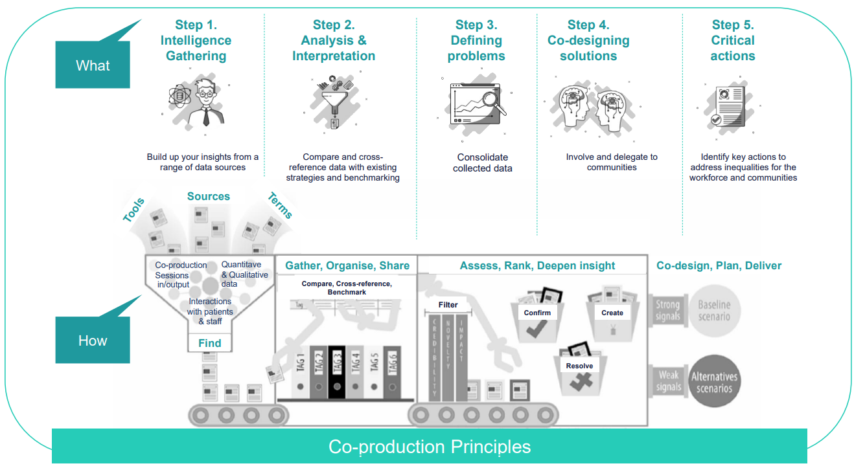
What & how?

Slide 4
How the approach has helped
Paediatric Respiratory Physiotherapy
IAPT DNA Rates
Poverty Proofing
Prioritise Waiting Lists
Data Recording and Quality
Culturally Appropriate Treatment
Digital Poverty
Embed HEAT
PC Access for LDA
Accessible Language
Withheld Phone Numbers
Autism Assessment Access
Step 1. Intelligence Gathering
Step 2. Analysis and Interpretation
Mental Health Act Detentions of people from Black ethnicity
Cancer Screening for LDA and SMI

Slide 5
Next Steps
Step 3. Defining problems
Step 4. Co-designing Solutions
Step 5. Critical Actions

Slide 6
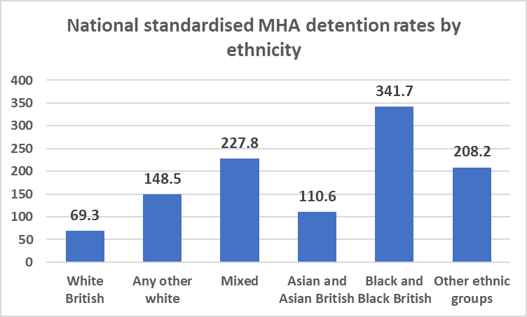
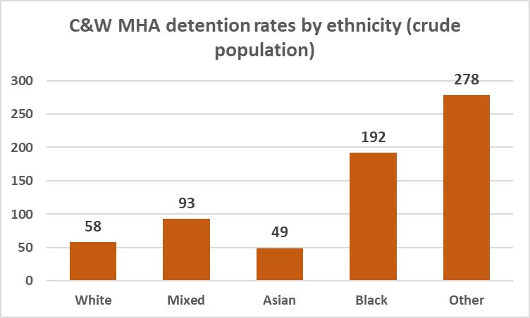
MHA Detentions – Example Process
Step 1 – Intelligence Gathering: we spoke to a range local communities, staff and VCSE who raised this as a priority Health Inequalities issue
Step 2 – Analysis & Data Interpretation: exploration of data showed that the national picture is stark: people from Asian backgrounds are 60% more likely to be detained than white counterparts, and people from Black backgrounds are 5 times more likely
Compared to local figures – in Coventry & Warwickshire, people from Asian backgrounds less likely to be detained and people from Black backgrounds are 3.3 times more likely

Slide 7
Next Step – 3. Defining Problems

Slide 8
Contact Details
Lexi Ireland Lexi.Ireland1@covwarkpt.nhs.uk

